Slide 1
Python basics and its modules for ML
Amirapu Raja Sekhar

Slide 2
Python Modules
Introduction to Python: Learn the basics of syntax, data types, variables, operators, and control flow.
Libraries for Data Science: Get familiar with NumPy, Pandas, and Matplotlib.
Functions and Modules: Understand how to define functions, use modules and packages, and write basic scripts.
Jupyter Notebook: Explore this powerful interactive environment for coding, data analysis, and visualization

Slide 3
Objectives
Learn how to Anaconda – download and install
Learn how to install virtual environment
Applications of python
Identifiers and variables
Data types in python
Operators
Conditional statements, loops
Operations on files
Types of sequences in python

Slide 4
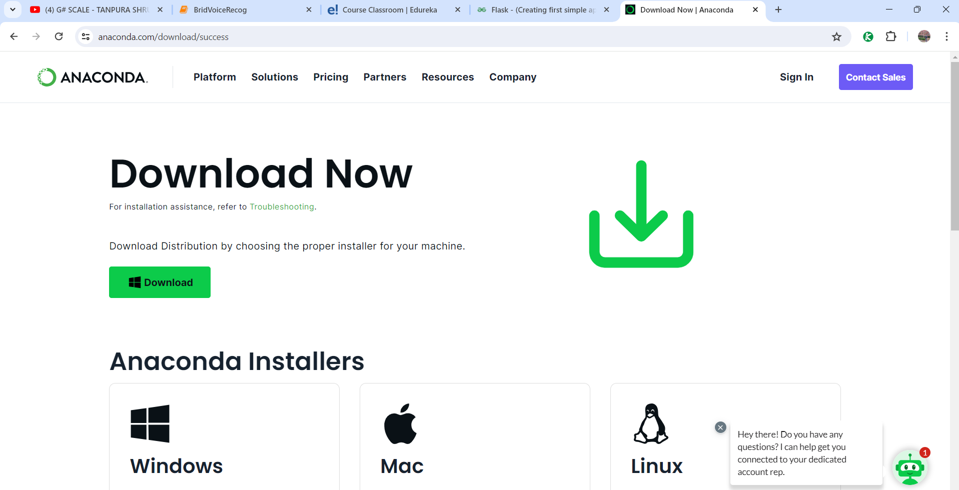
Anaconda download
Navigate to https://www.anaconda.com/download/success

Slide 5
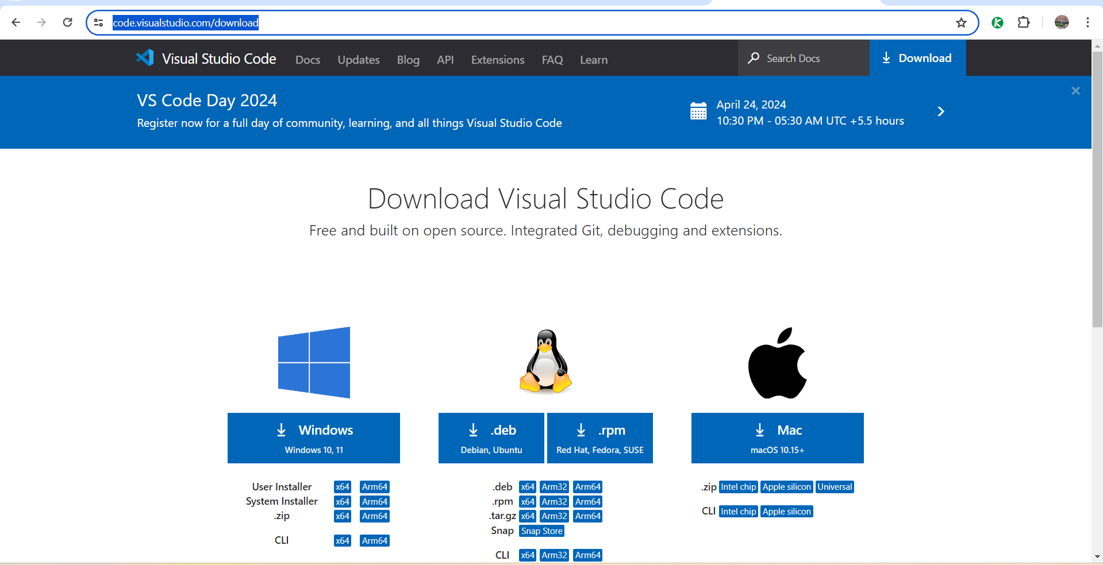
Download and install visual studio code
Navigate to https://code.visualstudio.com/download

Slide 6
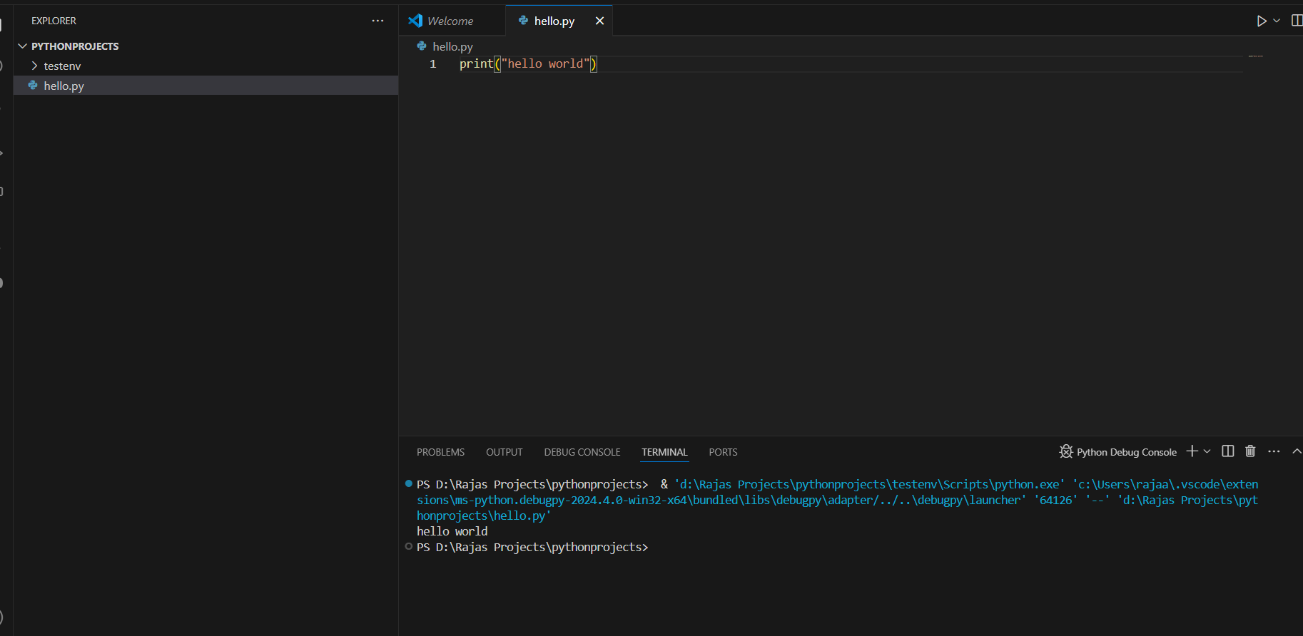
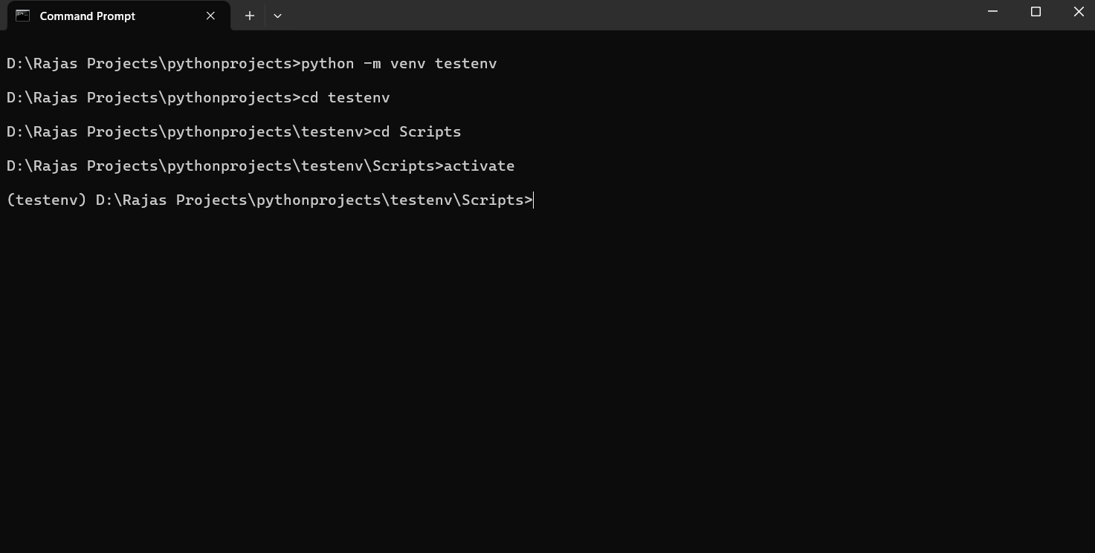
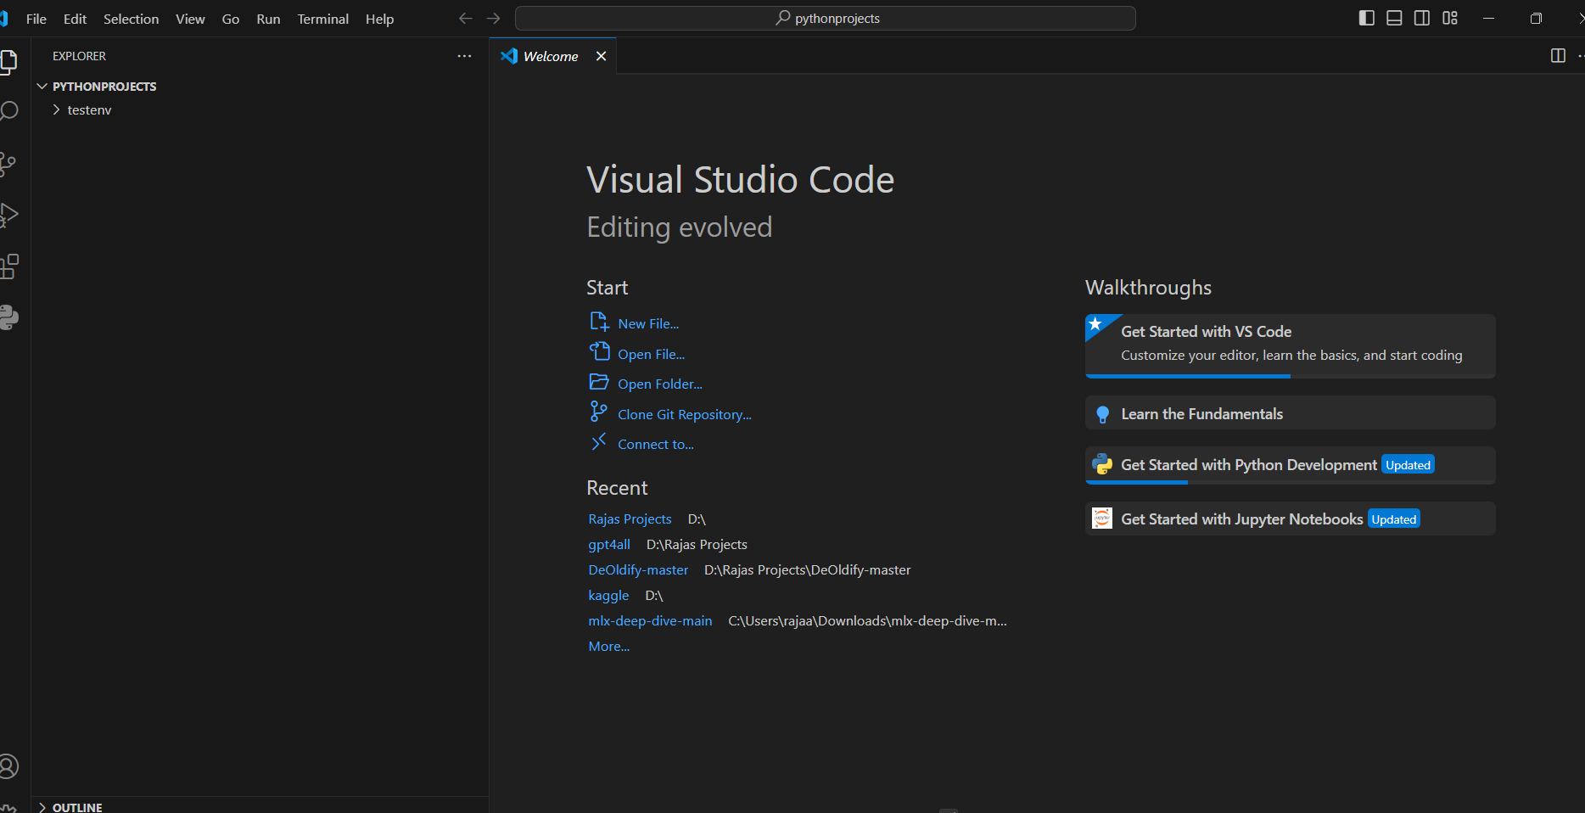
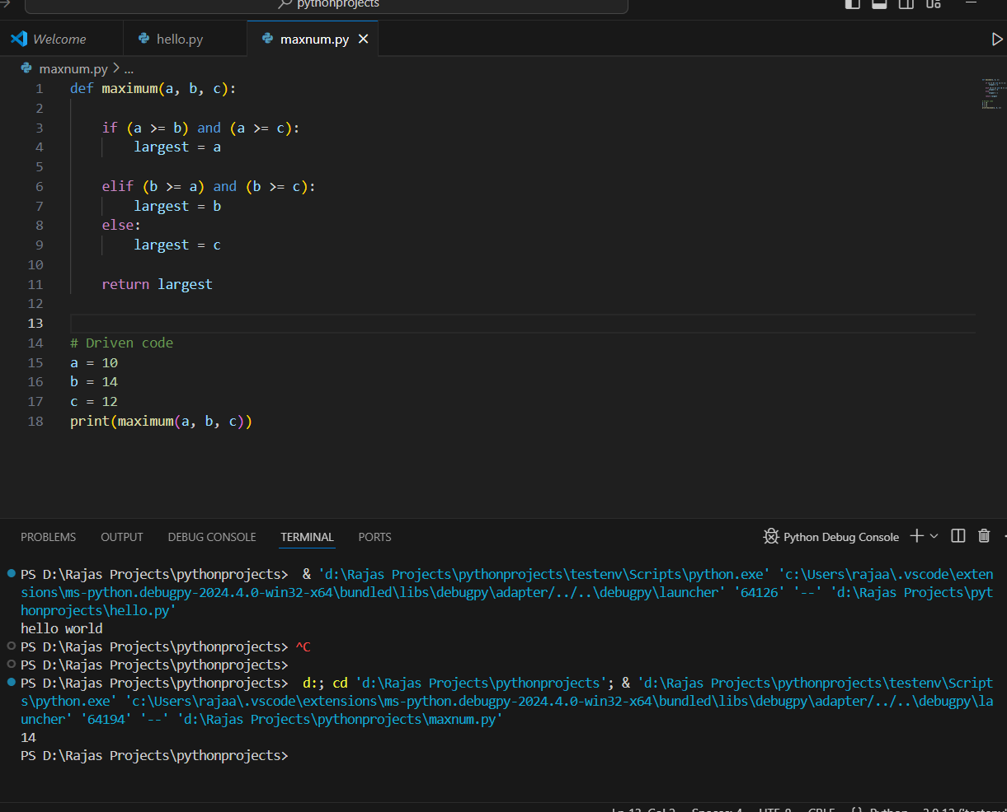
Virtual environment creation and activation
Create a folder in explorer where your python app

Slide 7
What is pip
Pip is a powerful tool in the Python ecosystem, essential for managing packages and dependencies effortlessly. As a Python fresher, understanding Pip is crucial for installing, upgrading, and removing packages with ease. With just a few simple commands, such as 'pip install' or 'pip uninstall', you can add or remove libraries to your Python environment. Moreover, Pip simplifies the process of ensuring your projects have all the necessary dependencies, streamlining development and enhancing productivity. Embrace Pip, and you'll find navigating the Python library landscape a breeze."

Slide 8
Python identifers
Valid identifiers:
var1
_var1
_1_var
var_1
Invalid Identifiers
!var1
1var
1_var
var#1
var 1

Slide 9
Variables
Variables are reserved memory locations where we store our values
A=16
B=60
C=“Raja”
A=16
B=60
C=“RAJA”

Slide 10
Applications of python
Web development
Testing
Web crawling
Computer vision
Machine learning
A.I.
Deep learning
Natural language processing

Slide 11
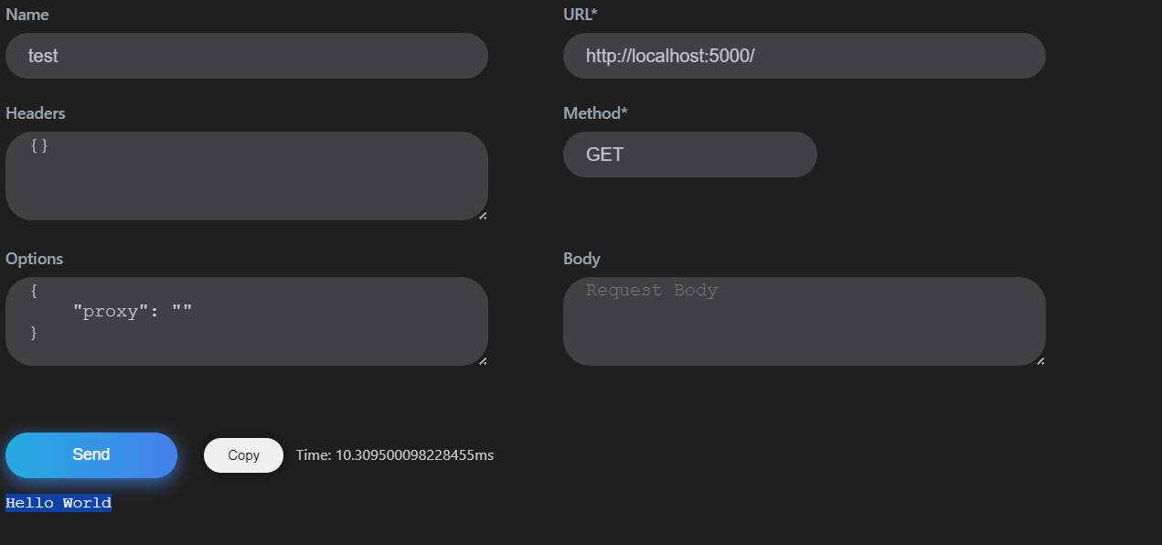
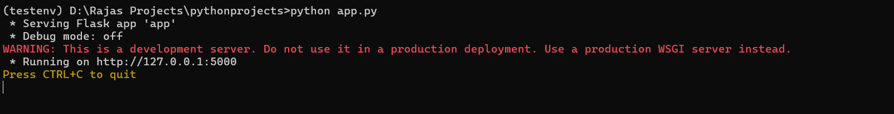
Web development
Flask application
Create a file a called requirements.txt
Add a line called Pip install flask
Navigate to command prompt where we opened earlier
Pip install -r requirements.txt
Now run the app python
Python app.py

Slide 12
Testing
Selenium packages are available
Performance testing
Python test framework
And many more

Slide 13
Web crawling
Web crawling
rom selenium import webdriver
chrome_options = ChromeOptions()
chrome_options.add_argument('--ignore-certificate-errors') # Ignore SSL certificate errors
# Merge ChromeOptions with desired capabilities
desired_capabilities = DesiredCapabilities.CHROME.copy()
desired_capabilities.update(chrome_options.to_capabilities())
# Initialize Chrome WebDriver with desired capabilities
driver = webdriver.Chrome(desired_capabilities=desired_capabilities)
browser = webdriver.Chrome()
river = webdriver.Chrome(options=chrome_options)
browser.get(line.replace("\n",""))
html_source = browser.page_source
html_source = browser.page_source
\

Slide 14
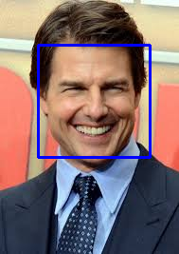
Computer vision
Face recognition using computer vision

Slide 15
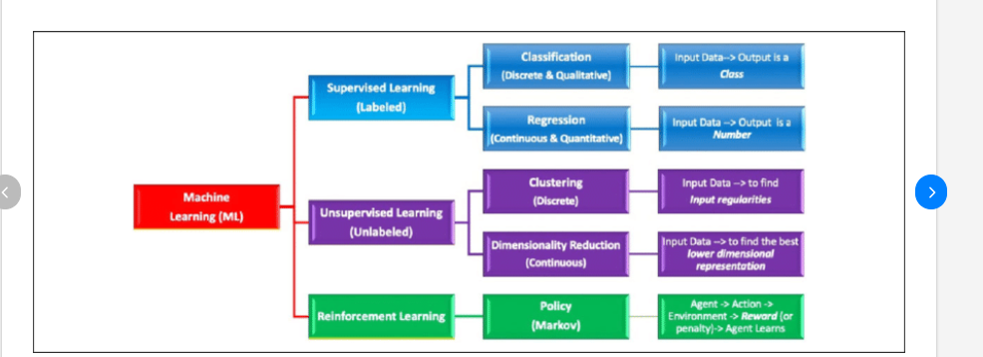
Machine Learning Overview

Slide 16
Machine learning libaries
SciPy:
SciPy is a Python library that builds on NumPy and provides a wide range of scientific computing functions, including signal processing, image processing, optimization, and statistics. SciPy is a valuable library for machine learning practitioners, as it provides many of the tools needed to prepare and process data for machine learning models.
Scikit-learn:
Scikit-learn is a Python library that provides a wide range of machine learning algorithms, including classification, regression, clustering, and dimensionality reduction. Scikit-learn is a popular library for machine learning beginners, as it provides a user-friendly interface and a well-documented API.
TensorFlow:
TensorFlow is a Python library developed by Google for numerical computation using data flow graphs. TensorFlow is a popular library for deep learning, as it provides a flexible and powerful framework for building and training deep neural networks.
PyTorch:
PyTorch is a Python library developed by Facebook for deep learning. PyTorch is a popular library for deep learning research, as it provides a dynamic and flexible programming environment for developing and experimenting with deep neural networks.
Keras:
Keras is a Python library that provides a high-level API for building and training deep learning models. Keras is a popular library for deep learning beginners, as it provides a user-friendly interface and makes it easy to experiment with different deep learning architectures.

Slide 17
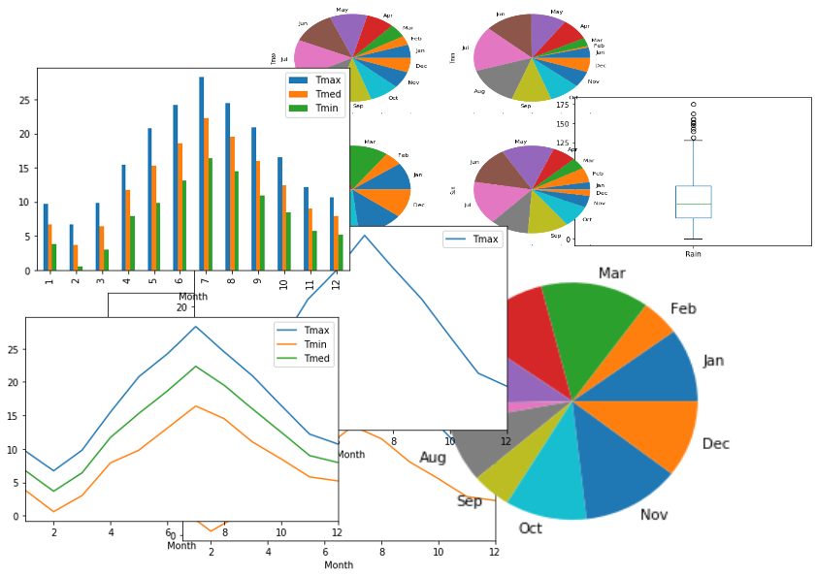
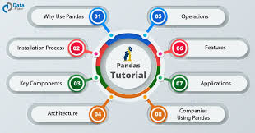
Pandas library

Slide 18
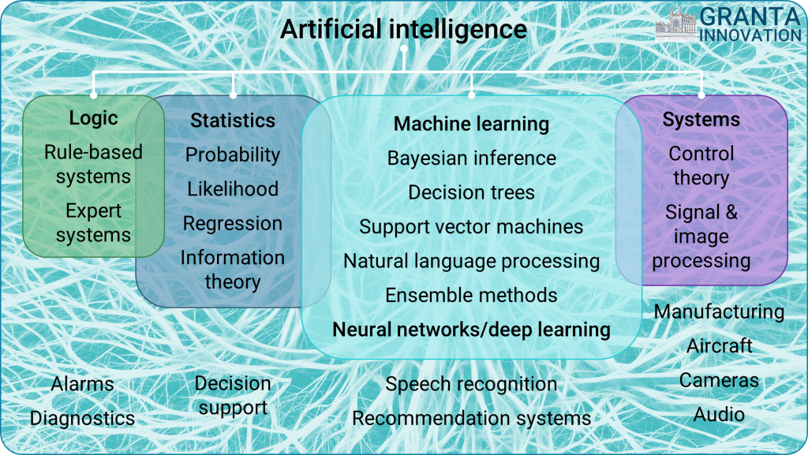
A.I and GPT

Slide 19
Python data types
Show some examples of datatype
Numeric Types: | int, float, complex
Sequence Types: | list, tuple, range
Mapping Type: | dict
Set Types: | set, frozenset
Boolean Type: | bool
Binary Types: | bytes, bytearray, memoryview
x = 5
print(type(x))
Varaibles names should be taken care we cannot have variable names as list/set etc. If we declare list as variable name we cannot use the list as datatype

Slide 20
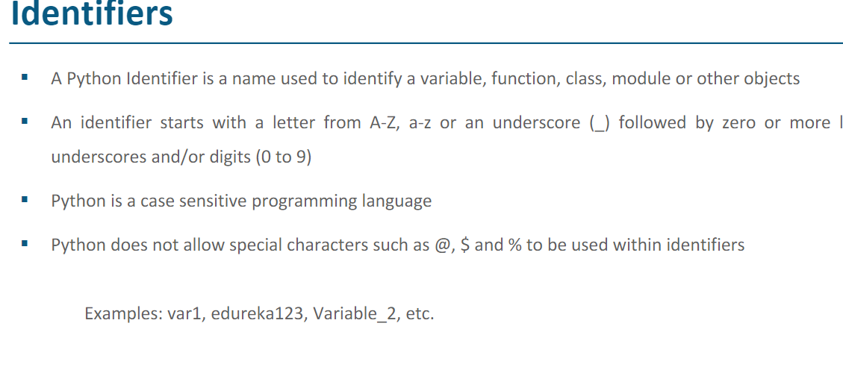

Slide 21
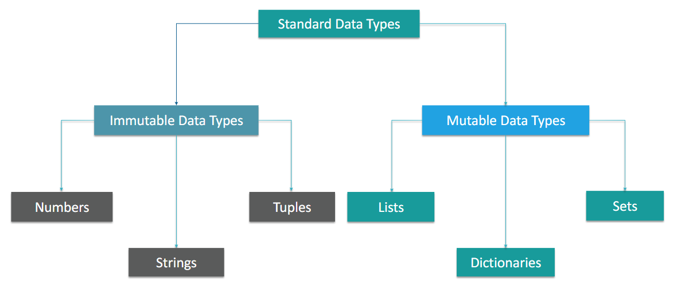
Data types

Slide 22
Mutable/Immutable datatype
In Python, data types are categorized as mutable and immutable based on whether their values can be changed after creation.
Mutable objects can be modified in place, while immutable objects cannot be altered once they are created.
Examples of mutable objects:
Lists, Dictionaries, Sets, and User-defined classes.
Examples of immutable objects:
Integers, Floats, Strings, and Tuples.
Here is an example of how mutable and immutable objects behave differently

Slide 23
# Create a mutable list
my_list = [1, 2, 3]
# Change the value of an element in the list
my_list[0] = 4
# Print the list
print(my_list)
# Create an immutable tuple
my_tuple = (1, 2, 3)
# Try to change the value of an element in the tuple
# This will result in a TypeError
my_tuple[0] = 4
# Print the tuple
print(my_tuple)

Slide 24
Python operators
Arithmetic → +,- *,/ **,//,%
Comparison → = !=,>,<,>=,<= etc
Bitwise → Binary and, binary or, binary xor,binary not
Membership
Assignment
Logical → and ,or,not
Identity → is ,is not
Membership in,not in

Slide 25
Conditional statements
def maximum(a, b, c):
if (a >= b) and (a >= c):
largest = a
elif (b >= a) and (b >= c):
largest = b
else:
largest = c
return largest
# Driven code
a = 10
b = 14
c = 12
print(maximum(a, b, c))
print(a|b)

Slide 26
Loops in Python
While
While else.
  i = 5 while i > 0: print(i) i -= 1 else: print("Liftoff!")
For Loop
Tqdm –package

Slide 27
More on conditional statements
Conditional statements (if, elif, else)
Loops (for loops, while loops)
Control flow with break, continue, and pass statements

Slide 28
If,Else, and Else Statements
def maximum(a, b, c):
if (a >= b) and (a >= c):
largest = a
elif (b >= a) and (b >= c):
largest = b
else:
largest = c
return largest
# Driven code
a = 10
b = 14
c = 12
print(maximum(a, b, c))
if condition:
statements
elif condition2:
statements
else:
statements

Slide 29
Loops
If condition is True
Types of Loop
Conditional code
Condition
While
Loop
If condition is False

Slide 30
While loop
while expression:
statements
Start
While condtion
False
True
Body of the loop
Exit

Slide 31
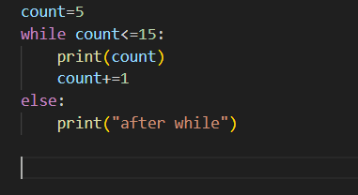
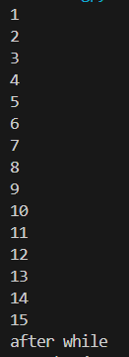
While loop
Conditional code
Conditional Code
Output
prints numbers 1 to 15

Slide 32
Number guessing game
import random
n = random.randrange(1,10)
guess = int(input("Enter any number: "))
while n!= guess:
if guess < n:
print("Too low")
guess = int(input("Enter number again: "))
elif guess > n:
print("Too high!")
guess = int(input("Enter number again: "))
else:
break
print("you guessed it right!!")

Slide 33
For loop
for i in range(100):
print(i)
Start the loop from 0.
Check if the current value of the loop variable is less than 100.
If the condition is true, print the current value of the loop variable.
Increment the loop variable by 1.
Repeat steps 2-4 until the loop variable reaches 100.
End the algorithm

Slide 34
For loop
Name=[“raja”,”Venkat”,”Pal”] → sequence
for name in Name: → Iterator
print(name)
Output:
raja
Venkat
Pal

Slide 35
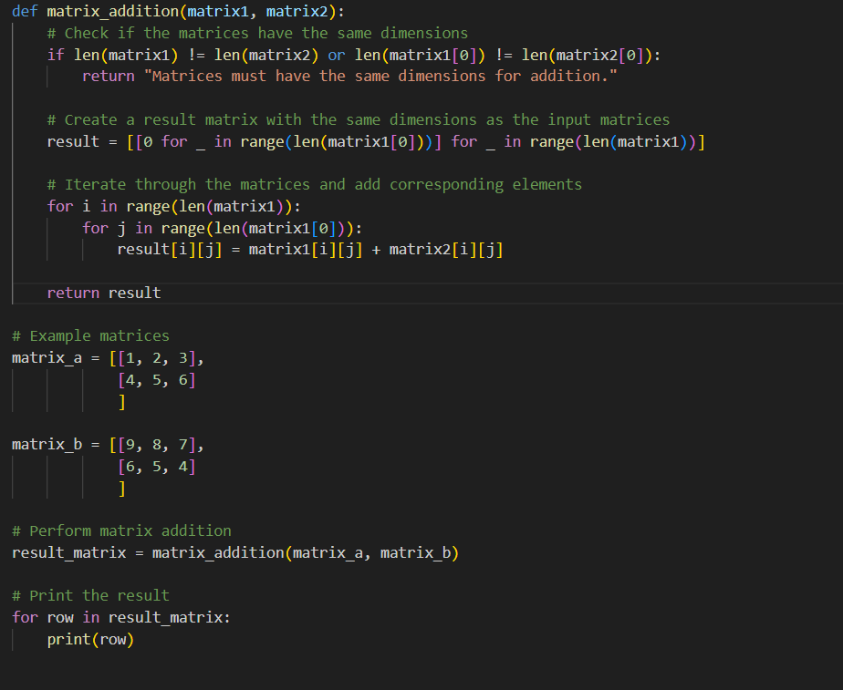
Matrix addition

Slide 36
Loop control statements
break stops the execution of a for loop while loop and pass execution to next statement
continue
Skips the execution of next statement and go to next index
Pass the pass statement in python is used when a statement is required in the absence of executing code. In other case its just a place holder
Pass and continue difference

Slide 37
Machine learning tips
Machine learning basic concepts classification regression
Ensemble models Random forest,xgboost dession trees etc
Identifying outliers
Dataset Imbalance methods
Imputation
Gradient decent
Crop detection use case based upon soil quality

